Slide 1
InformatIon Systems
Week 1 #2
IS 720 Research Methods & Ethics in IS

Slide 2
Computer-Based Information System
Peopleware
Software
Hardware
Processware
An Information System is an organized combination of people, hardware, software, communication networks and the data resources that collects, transforms and disseminates information in organization.

Slide 3
Information Systems Vs Information Technology
Information
Technology
Hardware
Software
Databases
Networks
Other…
Information
Systems
Payroll System
Inventory System
Marketing System
Customer Service System

Slide 4
Expanding Roles of IS
Data Processing: 1950s-1960s
Management Reporting: 1960s-1970s
Decision support: 1970s-1980s
Strategic and End User Support: 1980s-1990s
Global Internetworking: 1990s-2000s

Slide 5
Classification of IS
Information Systems
Operation Support System
Management Support System
Transaction Operating System
Process Control Systems
Office Automation Systems
MIS
DSS
EIS

Slide 6
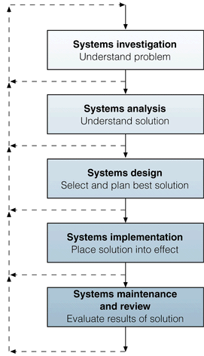
Information Systems Development

Slide 7
IS as Discipline
IS is an interdisciplinary field influenced by Computer Science, Political Science, Psychology, Operations Research, Linguistics, Sociology, and Organizational Theory.

Slide 8
